Slide 1

Breast Cancer Detection

Slide 2

Team Members
Asmaa Adel Omar
ID: 20180460
Abdelkarim Al-Dali GasmEl-bari
ID: 20180428

Slide 3
Agenda
Overview
Data Exploration using Python
RapidMiner
Python
Accuracy Comparison
Conclusion

Slide 4

Overview
Predict whether the cancer is benign or malignant using some classification algorithms

Slide 5
Data Exploration
We prepared data using “Python”.
There’s no missing values or duplicated values.
We use the describe() function to have a summary statistics.

Slide 6
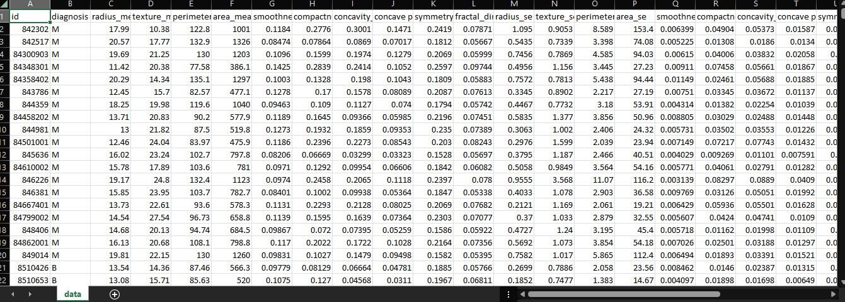
Data Set shape(569,33)

Slide 7
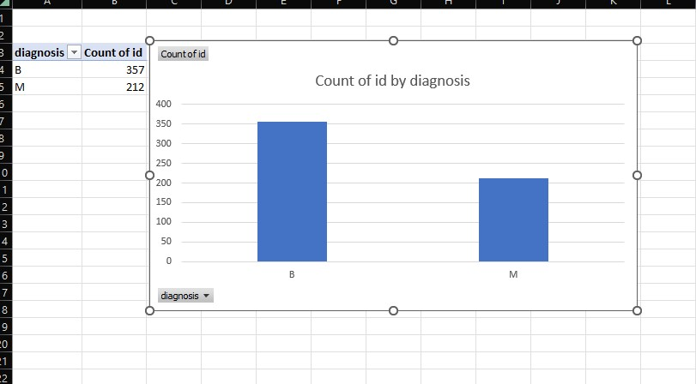
chart

Slide 8
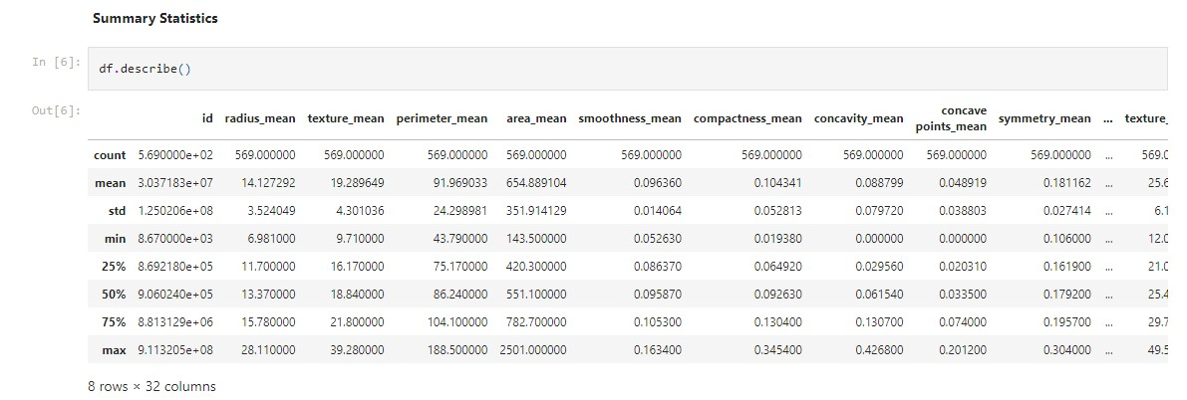
Summary statistics

Slide 9
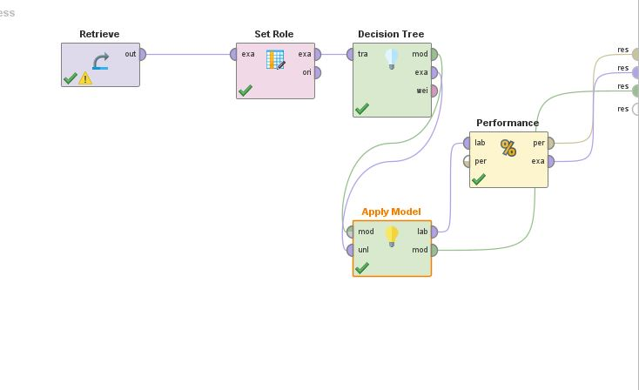
Rapid miner(Decision Tree)

Slide 10
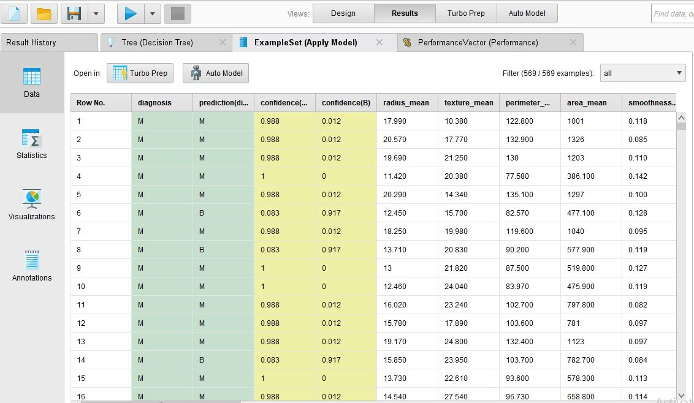
Rapid miner(Decision Tree)

Slide 11
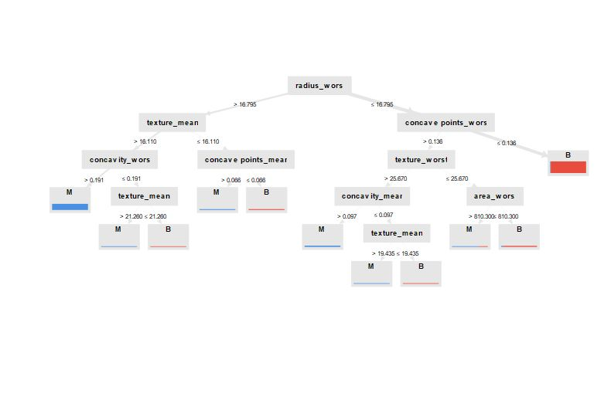
Rapid miner(Decision Tree)

Slide 12
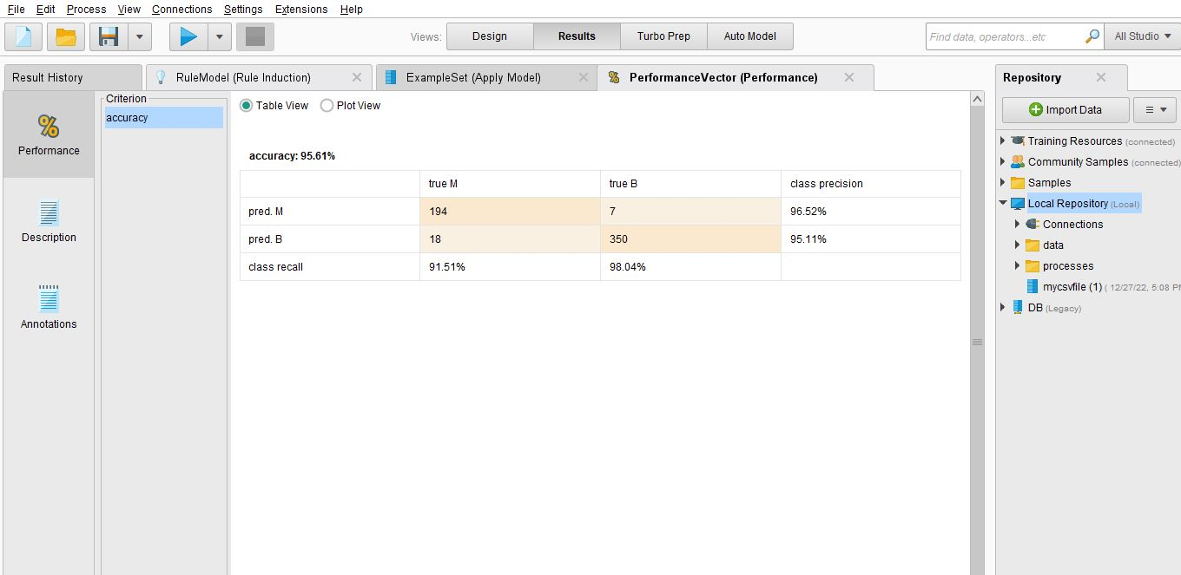
Rapid miner(Decision Tree)

Slide 13
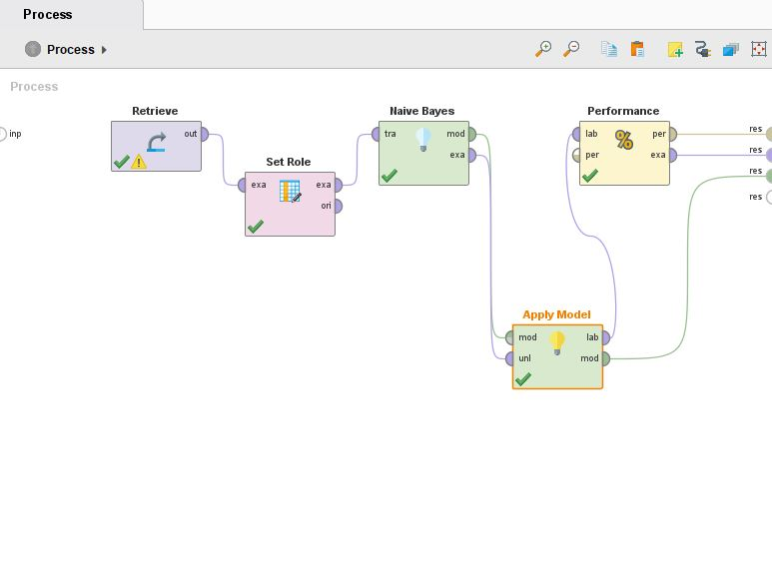
Rapid miner(Naïve Bayes)

Slide 14
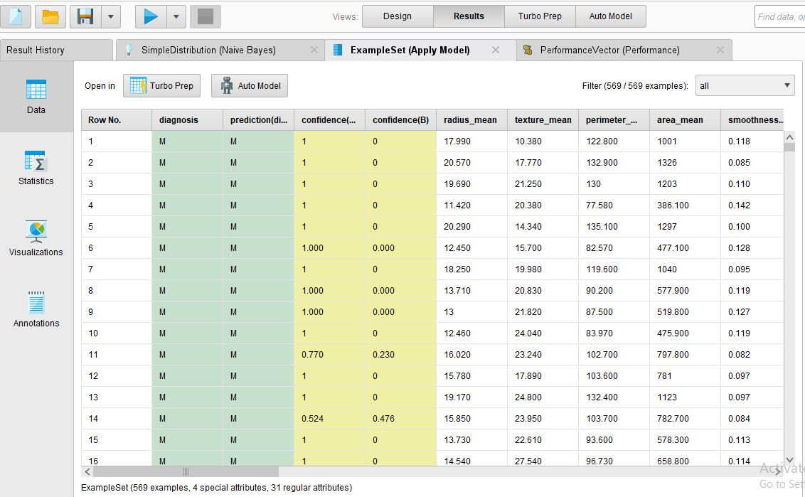
Rapid miner(Naïve Bayes)

Slide 15
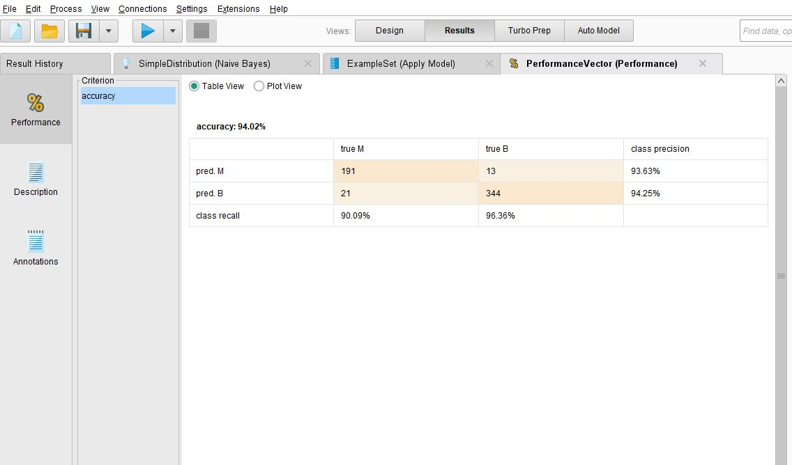
Rapid miner(Naïve Bayes)

Slide 16
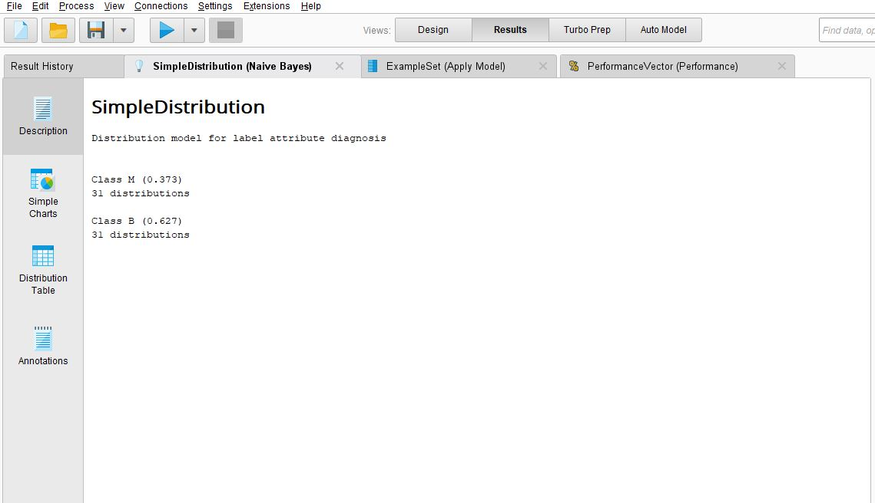
Rapid miner(Naïve Bayes)

Slide 17
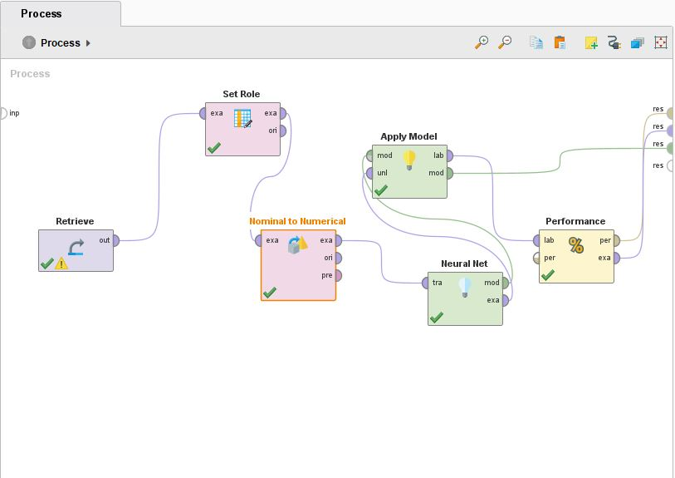
Rapid miner(Neural Network)

Slide 18
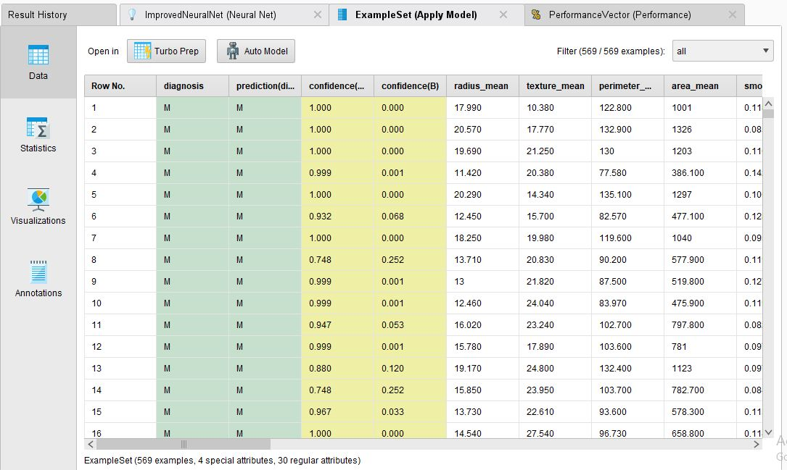
Rapid miner(Neural Network)

Slide 19
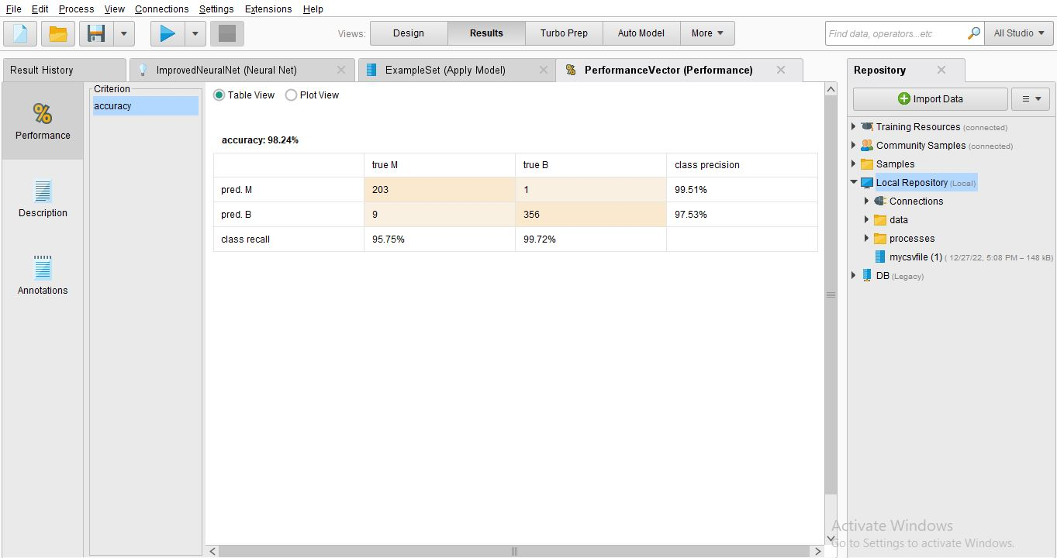
Rapid miner(Neural Network)

Slide 20
Rapid miner(Rule induction)

Slide 21
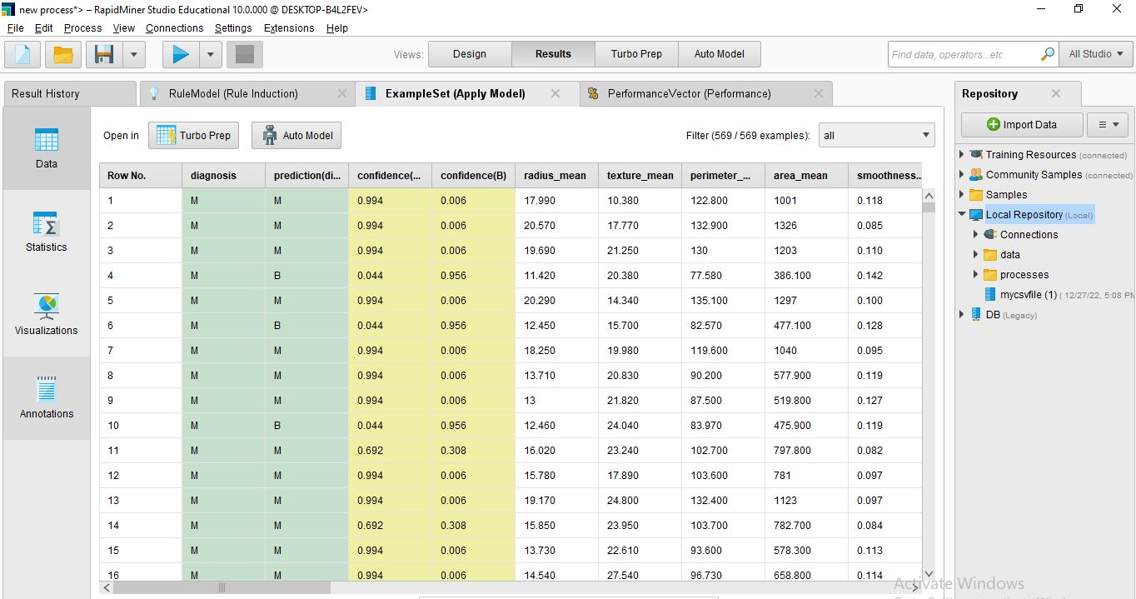
Rapid miner(Rule induction)

Slide 22
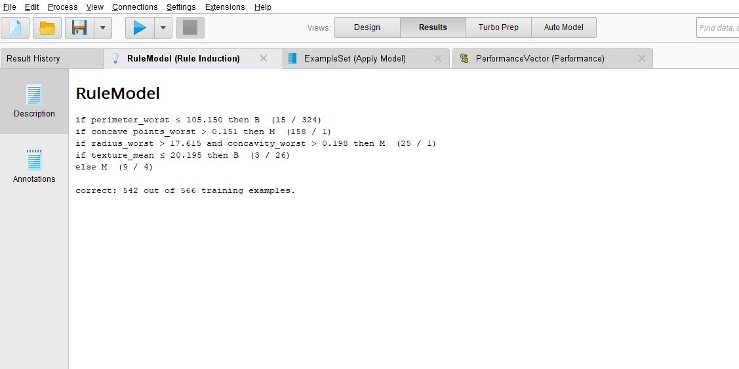
Rapid miner(Rule induction)

Slide 23
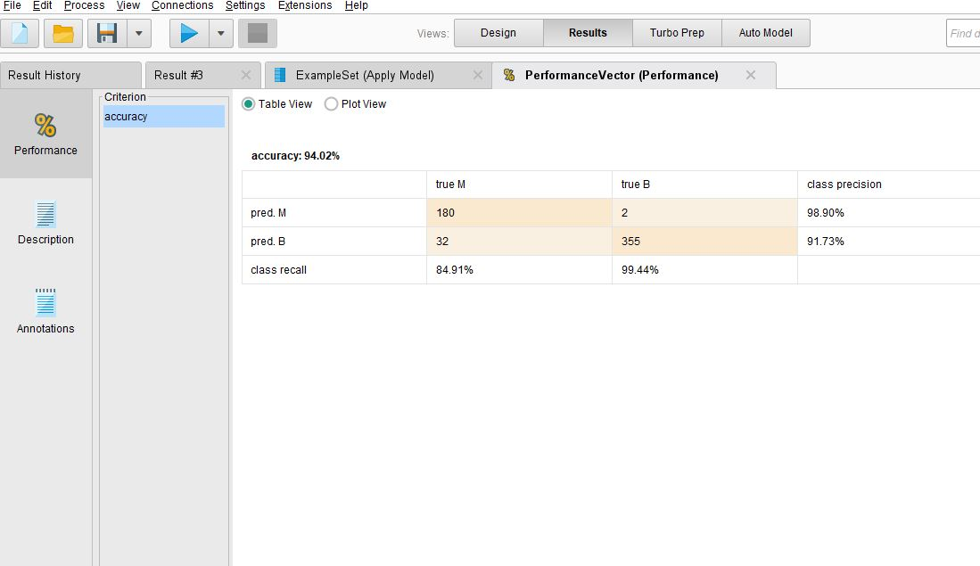
Rapid miner(Rule induction)

Slide 24
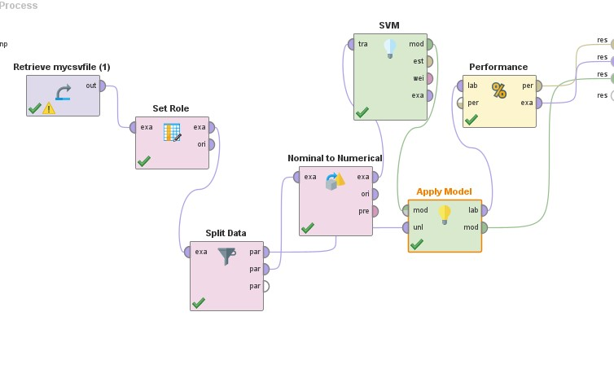
Rapid miner(SVM)

Slide 25
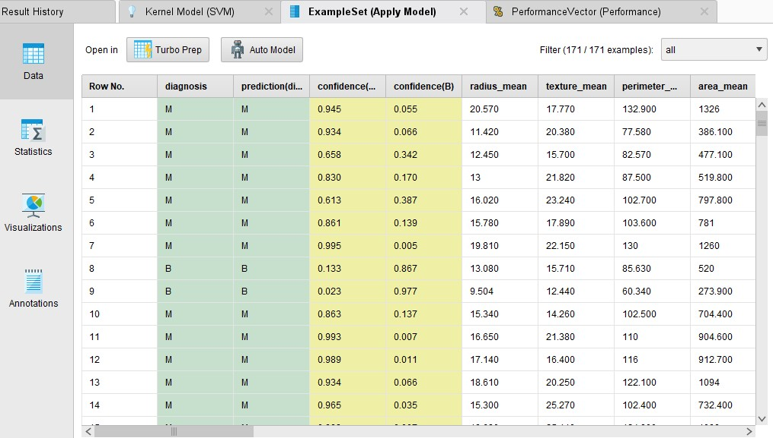
Rapid miner(SVM)

Slide 26
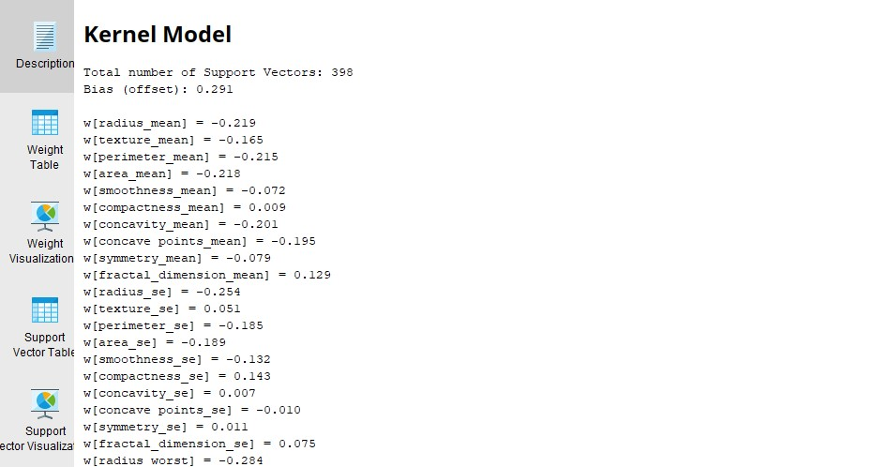
Rapid miner(SVM)

Slide 27
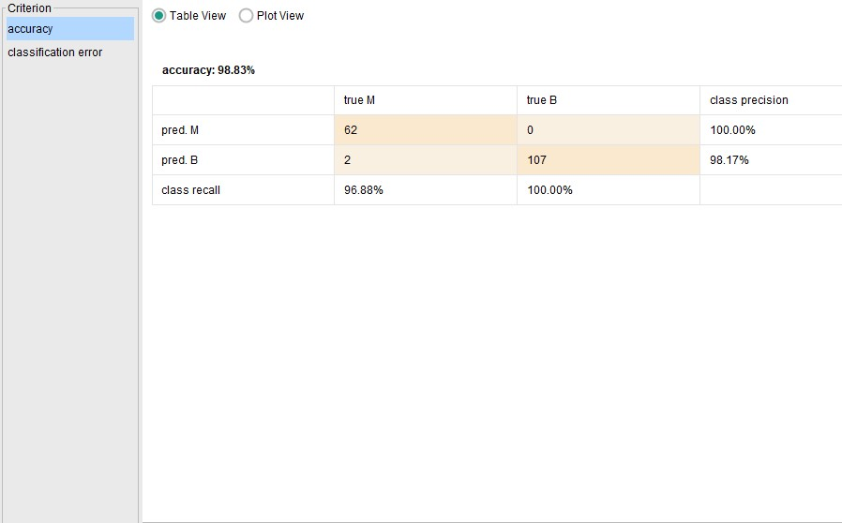
Rapid miner(SVM)

Slide 28
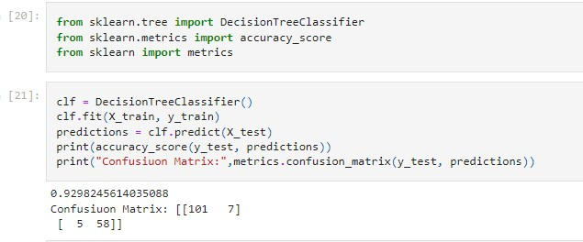
Python (Decision Tree)

Slide 29
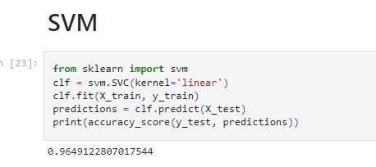
Python (SVm)

Slide 30
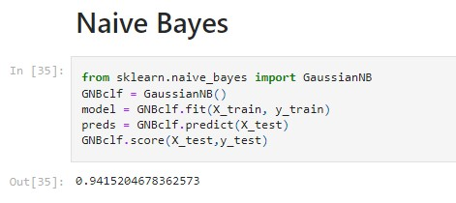
Python (Naïve bayes)

Slide 31
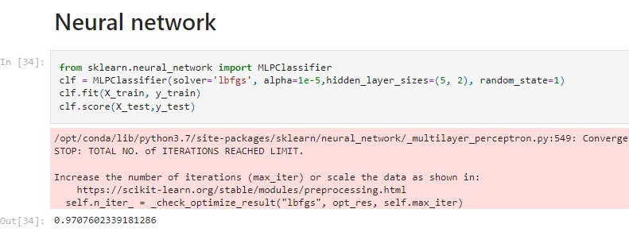
Python (Neural network)

Slide 32
Accuracy comparison
Rapid Miner | Accuracy
SVM | 98.83%
ANN | 98.24%
Decision Tree | 95.61%
Rule Induction | 94.02%
Naïve Bayes | 94.02%

Slide 33
Accuracy comparison
Python | Accuracy
Decision Tree | 92.98%
Naïve Bayes | 94.15%
SVM | 96.49%
ANN | 97.07%

Slide 34

Conclusion
From both “Rapid Miner” and “Python” we find the Neural Network algorithm got the highest accuracy so for future we will use them for breast cancer classification problem.

Slide 35

Thank you

